Slide 1
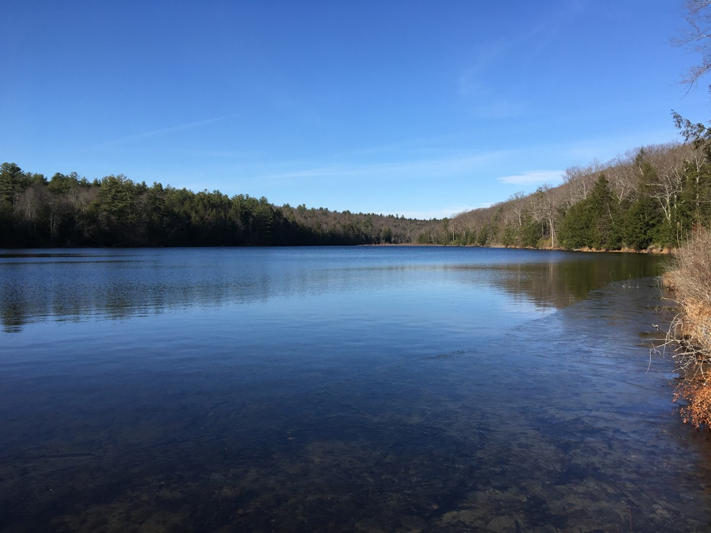
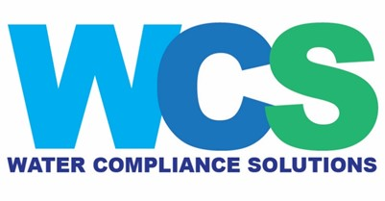
Water quality update for the Millville Elementary School March 21, 2024
Richard W. Gullick, PhD
Water Compliance Solutions, LLC
Leominster, MA
wcs.llc@comcast.net

Slide 2
Present status at Millville
HAA5 and TTHM levels good, and all regulatory standards are now met (and no HAA5 or TTHM violation Public Notice is required for 1st quarter 2024)
Fe/Mn removal still good
Water demand is created by MES staff flushing sinks to simulate student usage
Greensand system effluent chlorine residuals are more consistent when water demand is higher and filter operation is steadier
Planning to install automation to prevent chlorine residuals from getting too high even without operator attention
Water Compliance Solutions, LLC has resigned as Primary Operator and consultant for Millville effective April 1, 2024.
WCS’ mission was accomplished in terms of providing temporary operational services and bringing the system back into full regulatory compliance for HAA5 and TTHM
Dave Papale and Liz Afonso will work with McClure Engineering effective April 1, 2024
McClure Engineering will start serving as the Primary Operator on April 1, 2024

Slide 3
Millville Water Treatment System
Chlorine oxidizes most dissolved Fe + some Mn which is then captured by 18” of greensand filter (GSF) media
The chlorine creates a manganese dioxide coating on the GSF media that adsorbs the remaining dissolved Fe/Mn and allows it to be oxidized by chlorine over time (especially important for Mn)
Well pump runs based on storage tank levels (at ~6 gpm)
well
Bag filter (sediment)
add chlorine
greensand filter (Fe + Mn)
Chlorine in GSF effluent is monitored continuously. Normally desire a chlorine residual of 0.5 to 1.0 ppm, but lower levels are used at MES to minimize DBPs
Want [Mn] ≤ 0.015 ppm
corrosion control -raise pH to 7.0 - 8.0 with Na₂CO₃, also add PO₄ and Si
online chlorine monitor (want ~0.1 – 0.4 ppm)
10,500-gal storage tank
Pressure tank
UV
disinfection
Finished water to building

Slide 4
Treated water quality is typically good
Good Water Quality: Overall, the quality of the treated water at MES is quite good and currently meets ALL of the state and federal water quality regulatory requirements.
Historically had occasional issues with elevated haloacetic acids (HAA5) and color from manganese when the greensand chlorine residual was not in the target range.
The MES water meets all regulatory requirements for the following important water quality parameters:
Bacteria and other microorganisms
Haloacetic acids (HAA5)
Total trihalomethanes (TTHM)
Synthetic organic chemicals (SOCs)
Volatile organic chemicals (VOCs)
Per- and polyfluoroalkyl substances (PFAS)
Lead and copper
Heavy metals (mercury, cadmium, etc.)
Radiological substances
Nitrate and nitrite
Pesticides (insecticides, herbicides, rodenticides)
Algae and algal toxins
Taste and odor

Slide 5
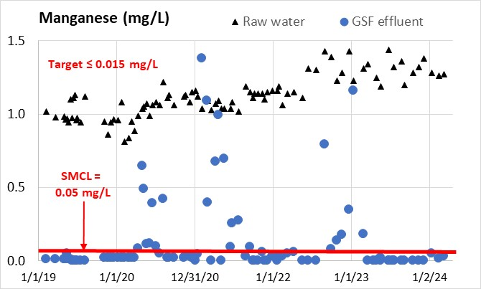
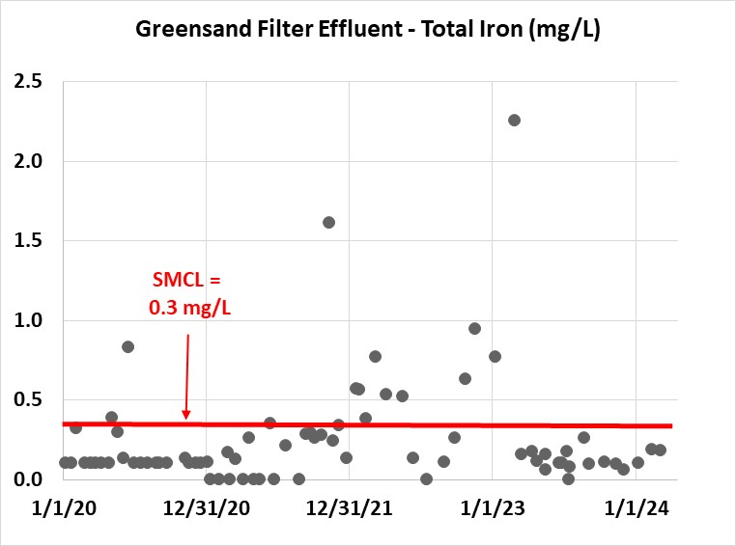
Manganese and Iron (GreensandPlus filtration)
New GS 2/22/23
New GS 2/22/23
All 18 samples for Mn since March 2023 met the SMCL of 0.05 mg/L, with 14 of 18 non-detect (< 0.02 mg/L)
All 18 iron samples since March 2023 have been below the SMCL of 0.3 mg/L

Slide 6
Haloacetic acids (HAAs)
HAA5 violations in recent years resulted in Public Notices
Compliance sample results in July – March all good for HAA5, averaging 32 ppb
MCL= 60 ppb, based on Locational Running Annual Average (LRAA)
MCL is based on consuming 2 liters (~ ½ gallon) each day for 70 years
Site DBP-1 is the bathroom next to room 111, and DBP-2 is Room 322

Slide 7
Total Trihalomethanes (TTHMs)
Compliance sample results were good in October thru March, averaging 45 ppb (59 ppb average for August thru March)
MCL= 80 ppb, based on Locational Running Annual Average (LRAA)
Site DBP-1 is the bathroom next to Room 111, and DBP-2 is Room 322

Slide 8
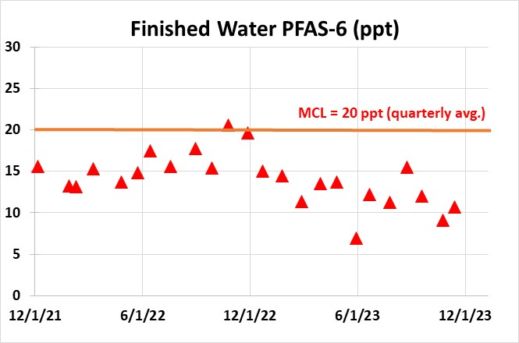
PFAS-6
PFAS = per- and polyfluoroalkyl substances
28 samples with no MCL exceedance
Last 12 months averaged 10.7 ppt with maximum 13.7 ppt
Likely future MCL for individual compounds and that would require treatment

Slide 9
Acknowledgements
Thank you to Dave Papale, Liz Afonso, and Mike Poitras for their dedication to the water system operations
Thank you to Bob Facey for his support with the data technology
Thank you to Scott, Matt and Denise at MES for their cooperation
Thank you to Peter Caruso for his partnership working on the water system over the past 4+ years

